Slide 1
Particle Therapy MasterClass
https://indico.cern.ch/event/840212/
Aris Mamaras (AUTh/CERN) and Yiota Foka (GSI/CERN)
on behalf of
IPPOG and IMC Steering Group

Slide 2
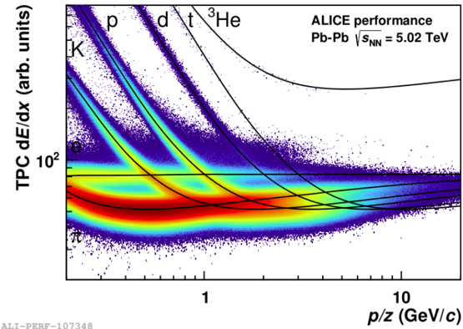
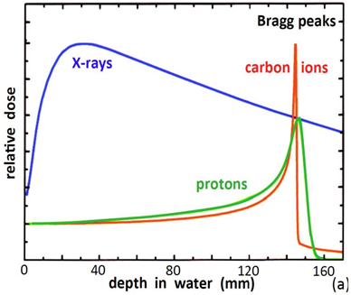
Particle Therapy MasterClass
https://indico.cern.ch/event/840212/
Aim: benefits for society from fundamental research
Direct applications for health of instrumentation and methods
developed for fundamental research: accelerators, detectors, software....
Aim: enhance awareness on HT cancer therapy possibilities
From Bethe Bloch ionization for PID to Bragg peak for cancer therapy

Slide 3
PTMC Participants, March 2021
Below, the Particle Therapy Masterclass links for each country are provided according to date together with the Video Conference indico pages:
6th of March, 2021:
Greece: https://indico.cern.ch/event/1013213/
Germany:
DKFZ: https://indico.cern.ch/event/1013218/
GSI: https://indico.cern.ch/event/1013220/
N. Macedonia: https://indico.cern.ch/event/1002980/
Portugal: https://indico.cern.ch/event/1013217/
8th of March 2021:
France: https://indico.cern.ch/event/1008495/
11th of March, 2021:
BiH, Sarajevo: https://indico.cern.ch/event/1013219/
Germany:
Dortmund: https://indico.cern.ch/event/1016281/
Iran: https://indico.cern.ch/event/1016282/
Czech Republic: https://indico.cern.ch/event/1016301/
Mexico: https://indico.cern.ch/event/1017427/
23rd of March, 2021:
Germany:
LMU: https://indico.cern.ch/event/1017203/
Italy: https://indico.cern.ch/event/1017224/
Latvia: https://indico.cern.ch/event/1017228/
Egypt: https://indico.cern.ch/event/1017230/
24th of March, 2021:
BiH, Tuzla: https://indico.cern.ch/event/1017746/
Lithuania: https://indico.cern.ch/event/1017747/
Russia: https://indico.cern.ch/event/1017750/
Egypt: https://indico.cern.ch/event/1017751/
Montenegro: https://indico.cern.ch/event/1017752/
26th of March, 2021:
Albania, Kosovo, N.Macedonia: https://indico.cern.ch/event/1013222/
Bulgaria: https://indico.cern.ch/event/1013225/
Serbia: https://indico.cern.ch/event/1013226/
Video Conference indico pages:
6th March: https://indico.cern.ch/event/999417/
8th March: https://indico.cern.ch/event/1008495/
11th March: https://indico.cern.ch/event/1016182/
23rd March: https://indico.cern.ch/event/999419/
24th March: https://indico.cern.ch/event/999420/
26th March: https://indico.cern.ch/event/999560/

Slide 4
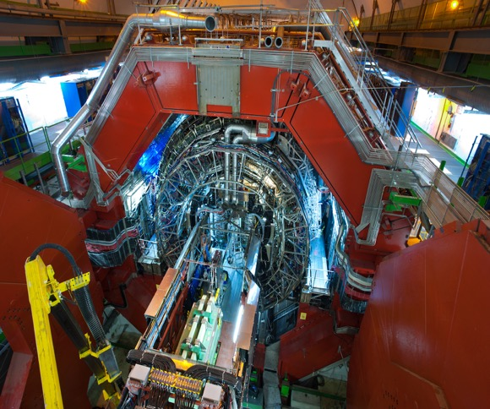
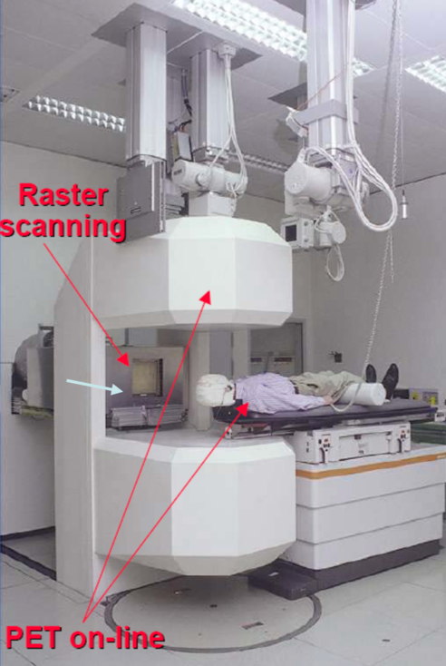
Heavy-ion research and heavy-ion therapy
Heavy-ions for QGP studies and heavy-ions for cancer therapy
Visit at CERN ALICE heavy-ion experiment, CNAO heavy-ion therapy center,
GSI heavy-ion research lab

Slide 5
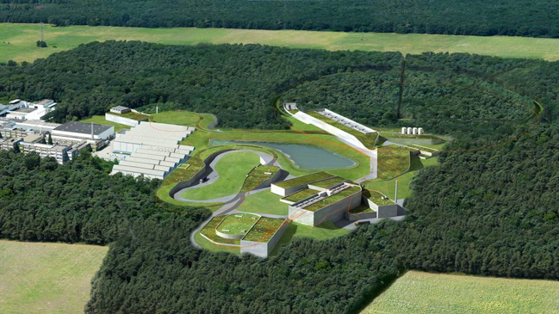
Heavy-ion research and heavy-ion therapy at GSI
Rasterscan Method
Implemented in the Heidelberg and Marburg Ion Treatment centers
(HIT and MIT) in Germany
Haberer et al., NIM A , 1993
Notes:
5

Slide 6
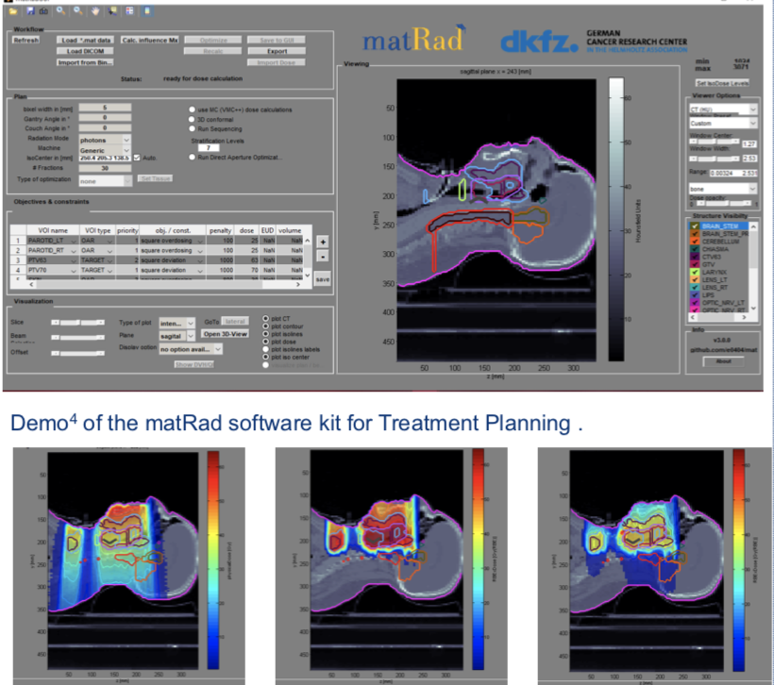
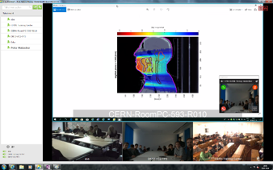
New PTMC and Treatment Planning
Based on professional open source treatment planning: matRad
developed by Heidelberg DKFZ www.matrad.org
Simplified version for PTMC
Using photons, protons and carbon ions

Slide 7
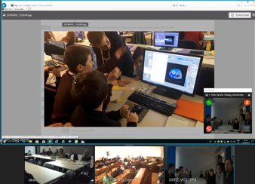
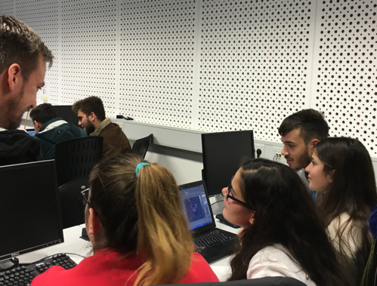
PTMC pilots in 2019
First local test: GSI, 7th February 2019
First international test: CERN, DKFZ, GSI, 5th April 2019
International MasterClasses
https://physicsmasterclasses.org/
CERN, DKFZ, GSI
Survey: positive results from students
Hope and motivation to contribute
to the fight against cancer

Slide 9
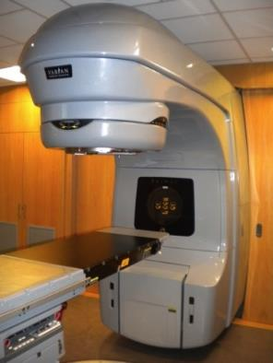
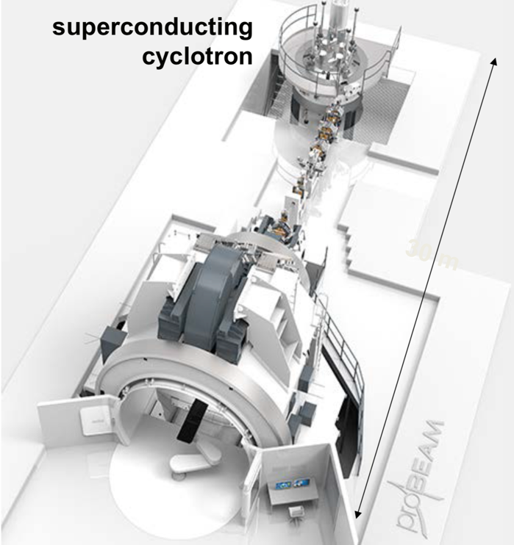
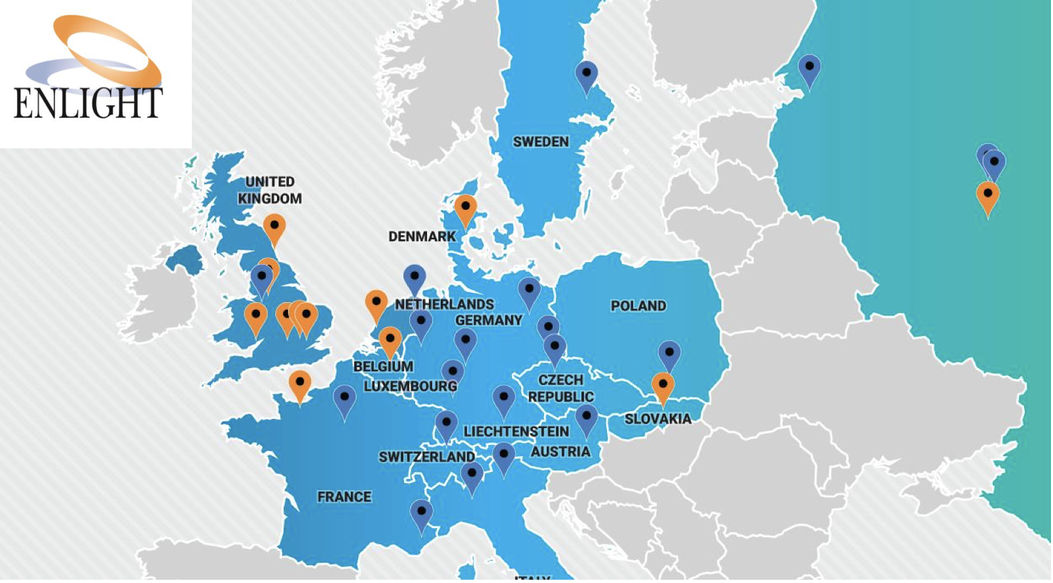
Accelerators for health
Conventional x-ray
Radiotherapy
Particle/Hadron Therapy with protons
Hadron Therapy centers in Europe (2018)

Slide 10
Heavy-ion research and heavy-ion therapy
Pb-Pb at 5.5 TeV
pp at 14 TeV
88-430 MeV/u carbon
50-221 MeV/u protons

Slide 11
Important Links
Useful information about the PTMC, in a variety of languages, can be found through the web page and the Google Drive links, provided below:
PTMC Indico page: https://indico.cern.ch/event/840212/overview
Google Drive: https://drive.google.com/drive/folders/1jRnLf49N_yRoOGg8V8vwq3DIpnetWdF0?usp=sharing
Material for the matRad installation and some important steps can be accessed through the word document in the link below, together with a video describing the procedure:
Installation: https://drive.google.com/file/d/1vT9tQ9ft1C7AwUSbU18pftC9H-ep4BPC/view
Video: https://drive.google.com/file/d/1BdkjN63StX-1kFEqR_FgTgj_pgZ2-PhL/view?usp=sharing
Additional instructions for the use of matRad are provided through the workflow, which is available in many languages through the PTMC indico page link and a video describing a simulation of the software is provided as well:
Workflow: https://indico.cern.ch/event/840212/page/17991-workflow
Video: https://drive.google.com/file/d/1jyCzJFfS7I_-0e45ZEcyb4fnXTaRJmpK/view?usp=sharing
Units and terminology of matRad can be found here:
Link: https://indico.cern.ch/event/840212/page/18006-definitions

Slide 12
We are ready to move on to the software!

