Slide 1
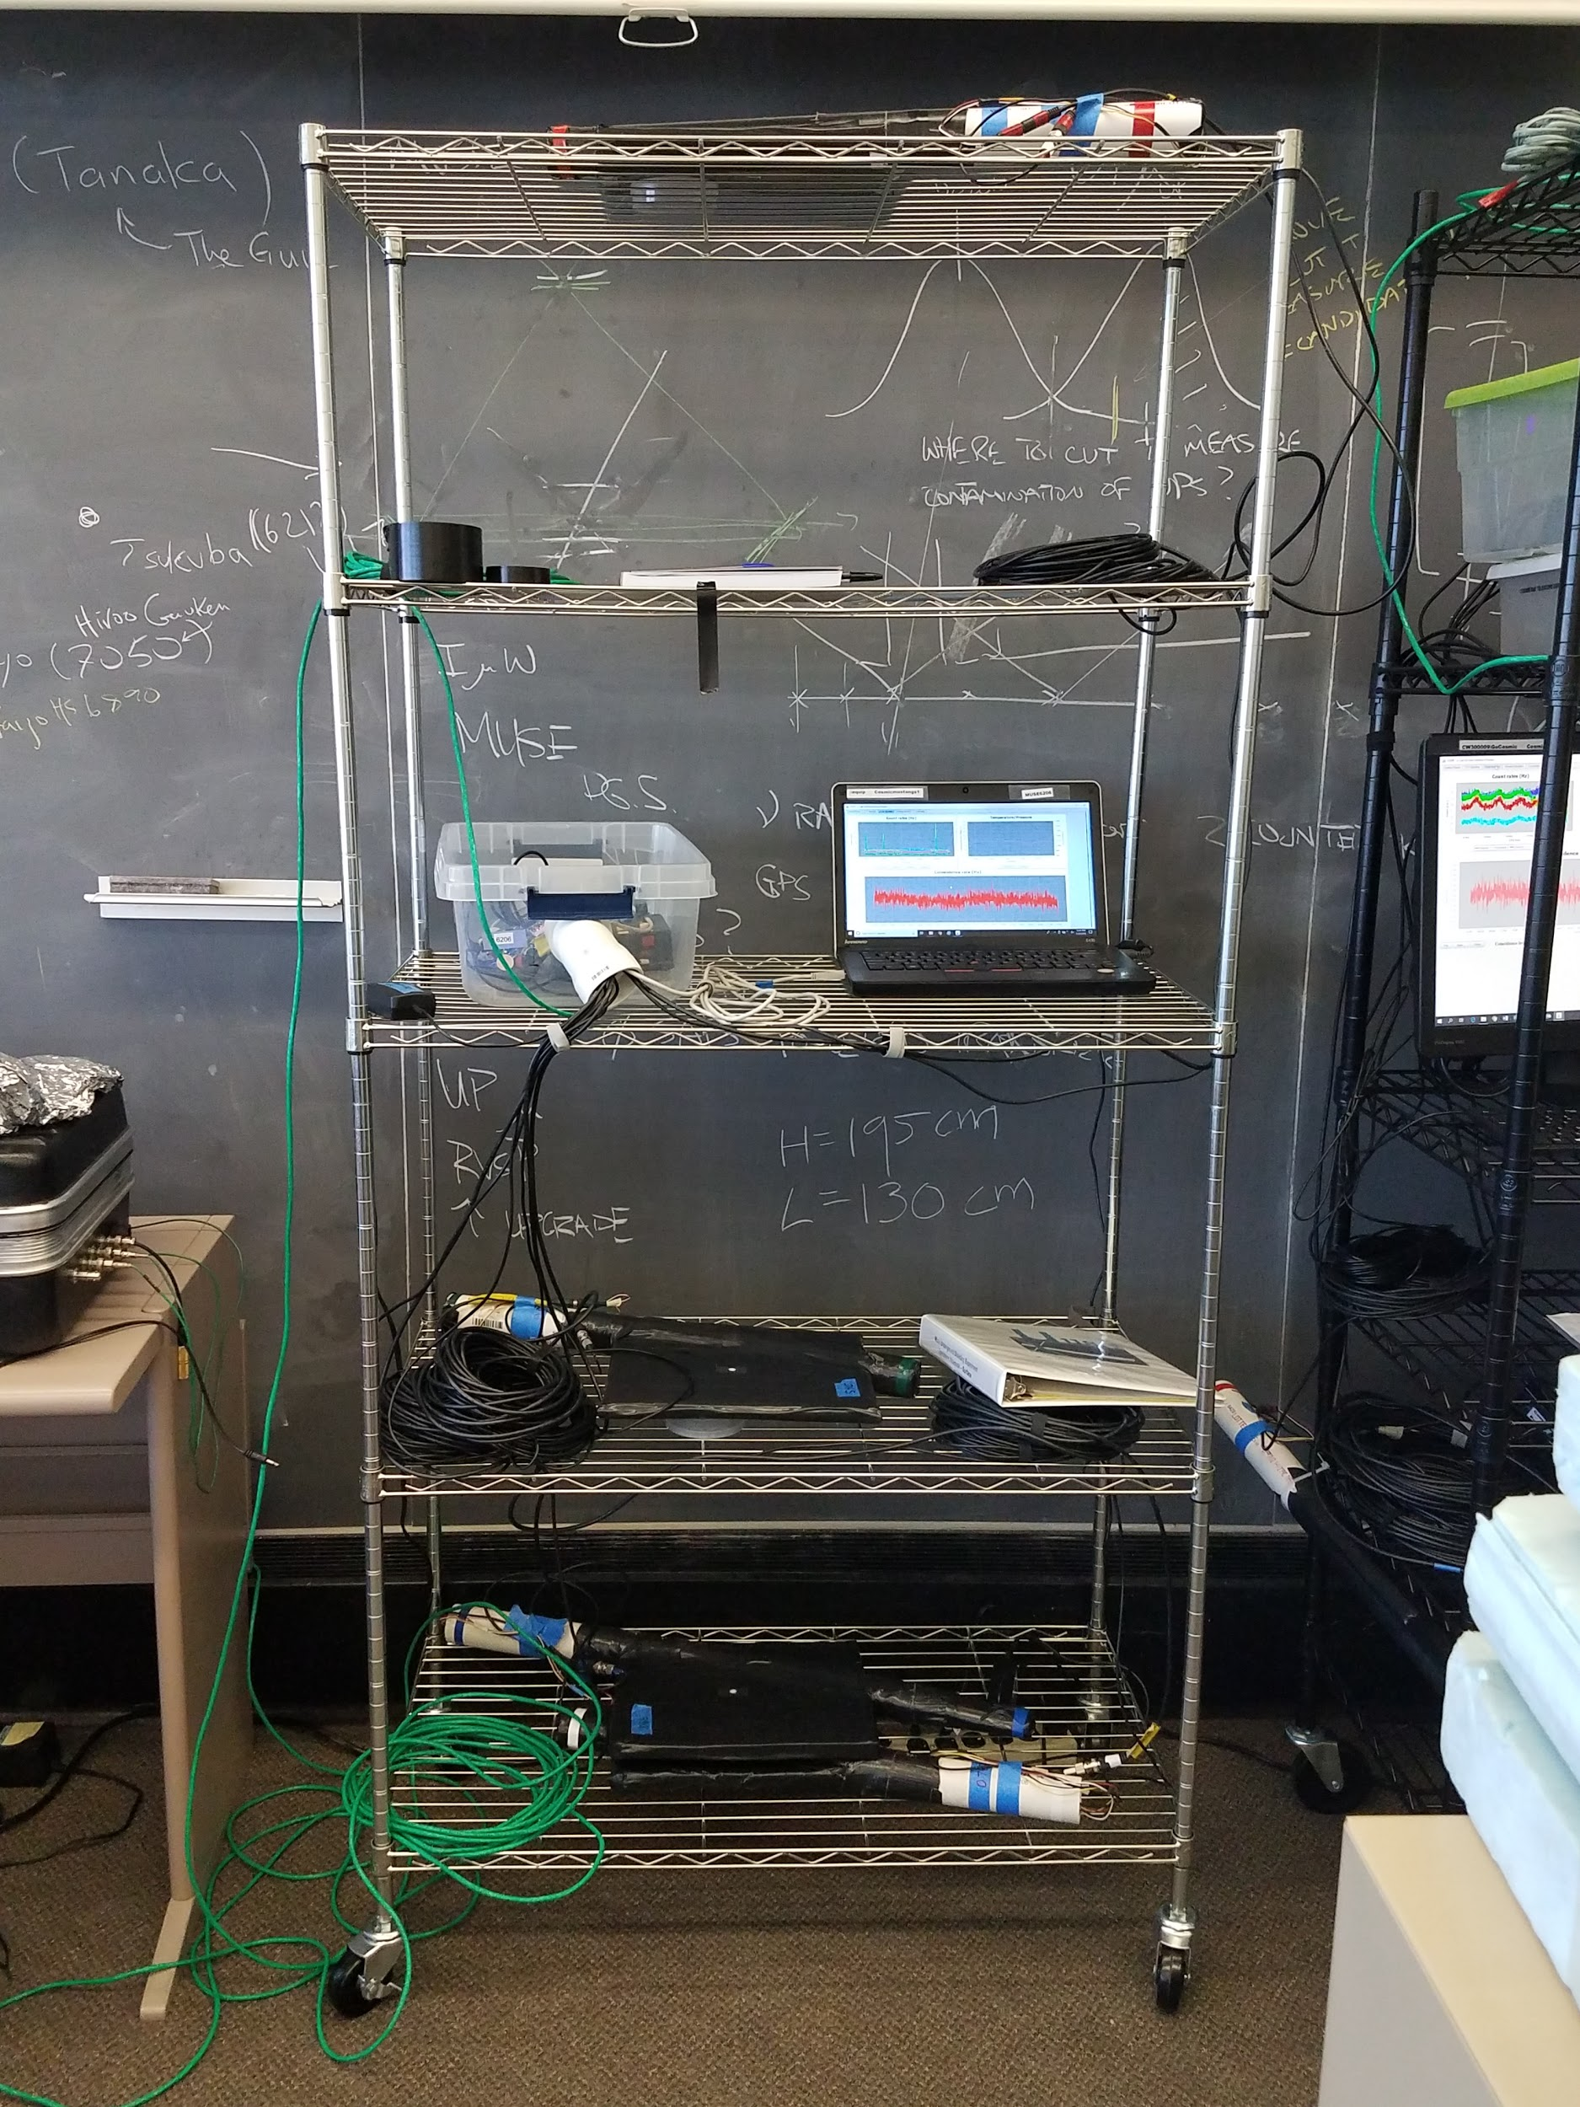
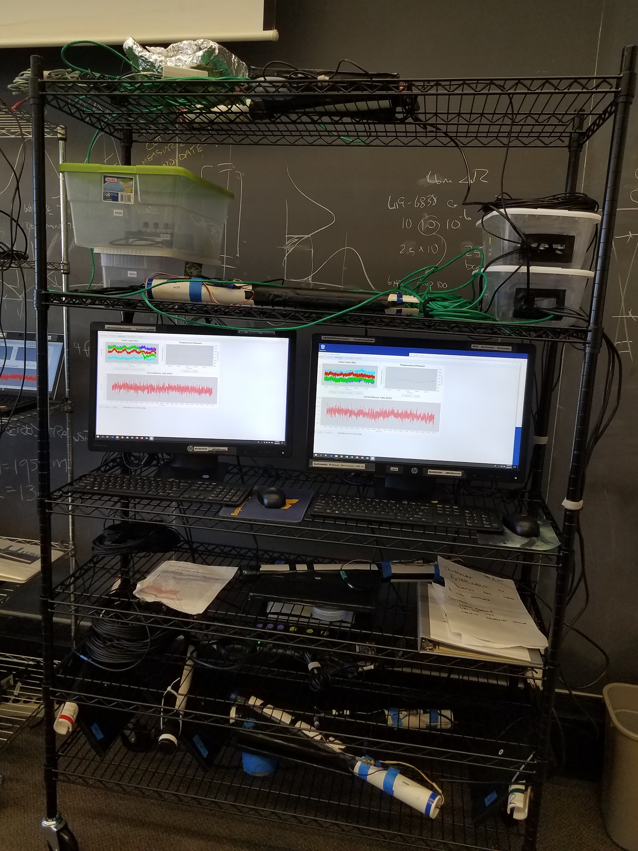
High School Muon Underground Shielding Experiment
New Trier HS
Glenbrook North HS
Ida Crown HS
Downers Grove South HS
Rochelle Zell HS
Naperville Central HS
University of Illinois at Chicago QuarkNet
Goals
Measure the change in cosmic ray muon flux in the MINOS neutrino tunnel as we move downstream from the access shaft.
Measure the change in flux as we descend to the tunnel in the elevator.
Monitor three angular acceptances simultaneously.
Add results from this measurement of vertical cosmic ray muons to the previous large angle measurements from MINOS
Setup
Tunnel Beam = TB
Tunnel Cosmic Ray = TC
TB inputs: 1,2,3,4
muon trig beam = 124
muon trig shaft = 13; 23
TC inputs: 1,2,3,4
muon trig large acceptance = 12
cosmic trig medium acceptance = 123
cosmic trig large acceptance = 124 or 1234
Three Detectors:
One to monitor cosmic rays above ground as a control.
An identical detector (TC) to measure the rate underground.
A third detector (TB) to measure the muon background in the neutrino beam.
The cosmic ray detectors simultaneously record data in wide (150 deg), large (21 deg), and small (6 deg) angular acceptance modes.
Tunnel Cosmic Ray (TC) stack is vertical.
Tunnel Beam (TB) stack looks for horizontal (beamline origin) muons as a veto for TC.
cosmic ray muon
TC4
TB3
TC3
TB1
TB4
TC2
TB2
Acknowledgements
beamline muon
TC1
Thank you to Fermilab for allowing us to use their facilities through the approval of TSW 1548. We acknowledge the National Science Foundation for their fiduciary assistance in establishing and maintaining QuarkNet (Grant #1806631). We would like to extend additional thanks to administrators of the affiliated schools for their continued support of this project.
Surface Module
Tunnel Module
March 2019

